Slide 1
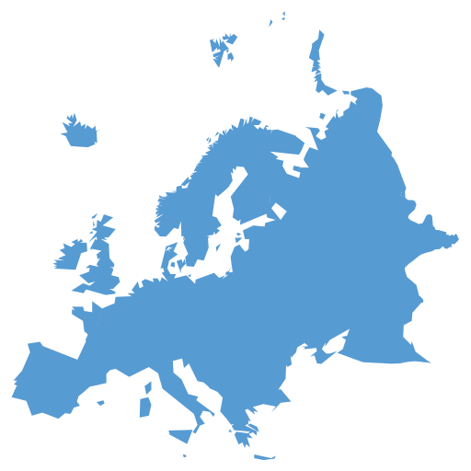
Languages take you places
Do now: If you could speak any language in the world, which one would you like to speak and why?
Knowing languages can open many doors for you as you explore cool places around the world.
Can you guess where’s Wally by looking at the language, the main landmark and the flag?
Notes:
Quick discussion, then introduce competition

Slide 2
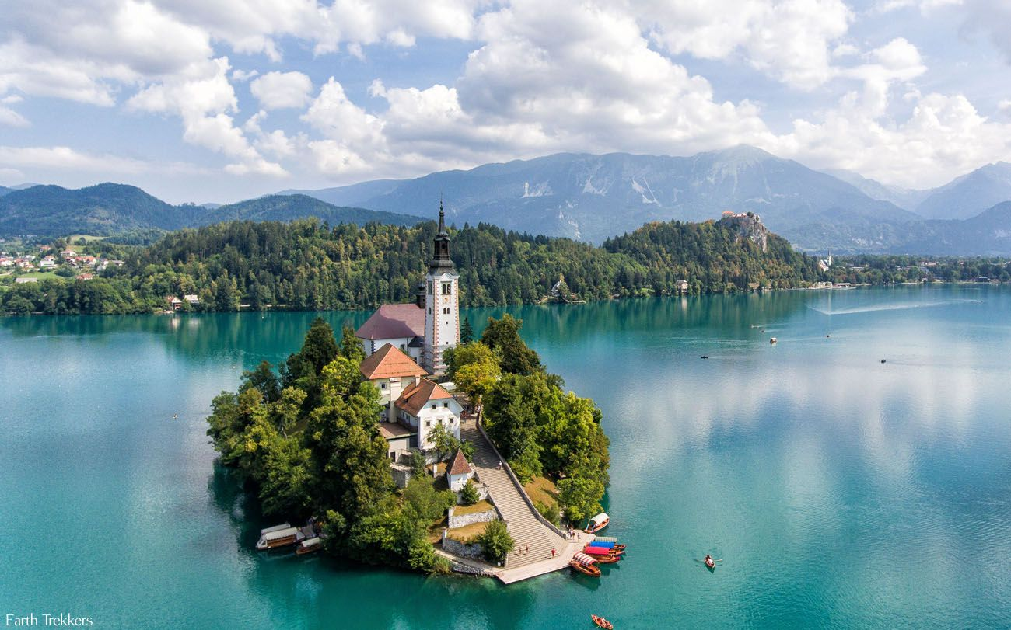
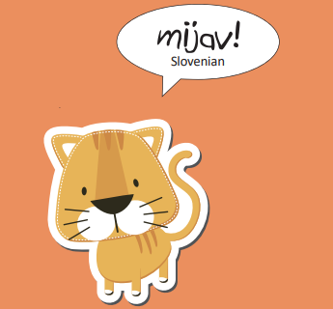
Where’s Wally?
1
Can you guess the country?
Notes:
Lake Bled, Slovenia

Slide 3
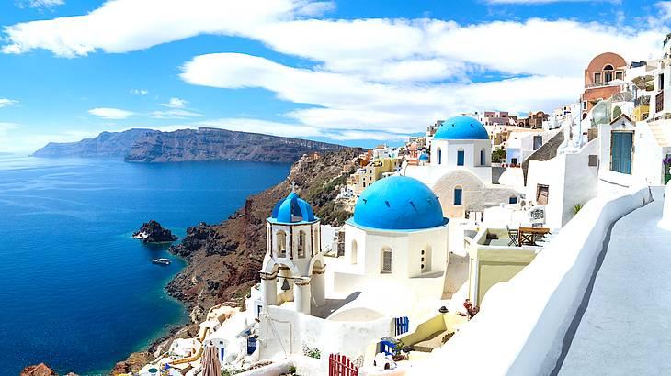
Where’s Wally?
2
Can you guess the country?
Notes:
Santorini, Greece

Slide 4
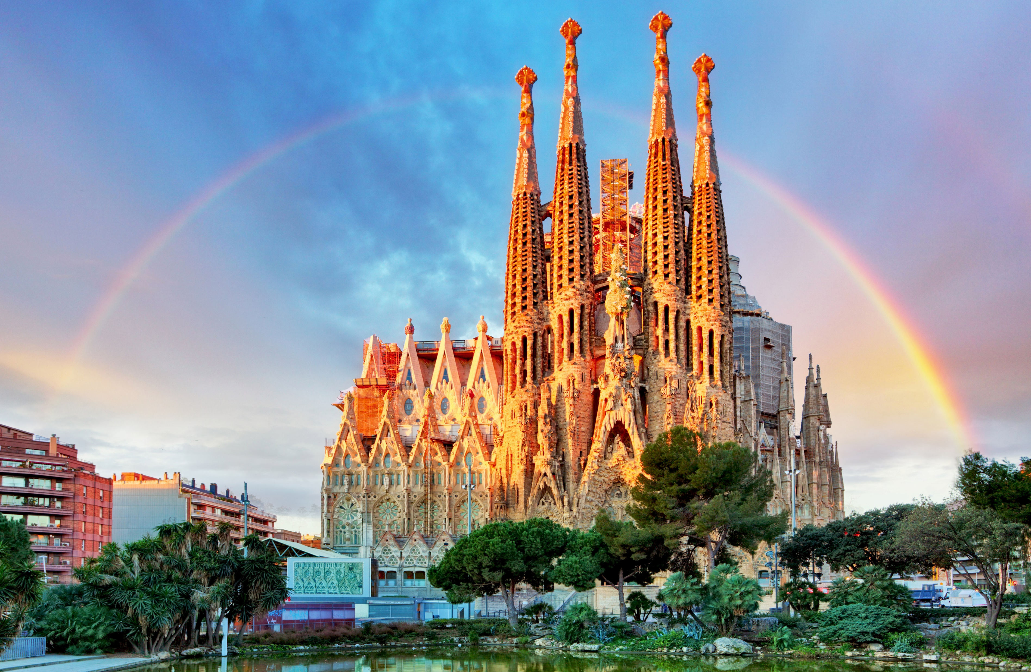
Where’s Wally?
3
Can you guess the country?
Notes:
Sagrada Familia, Barcelona, Spain

Slide 5
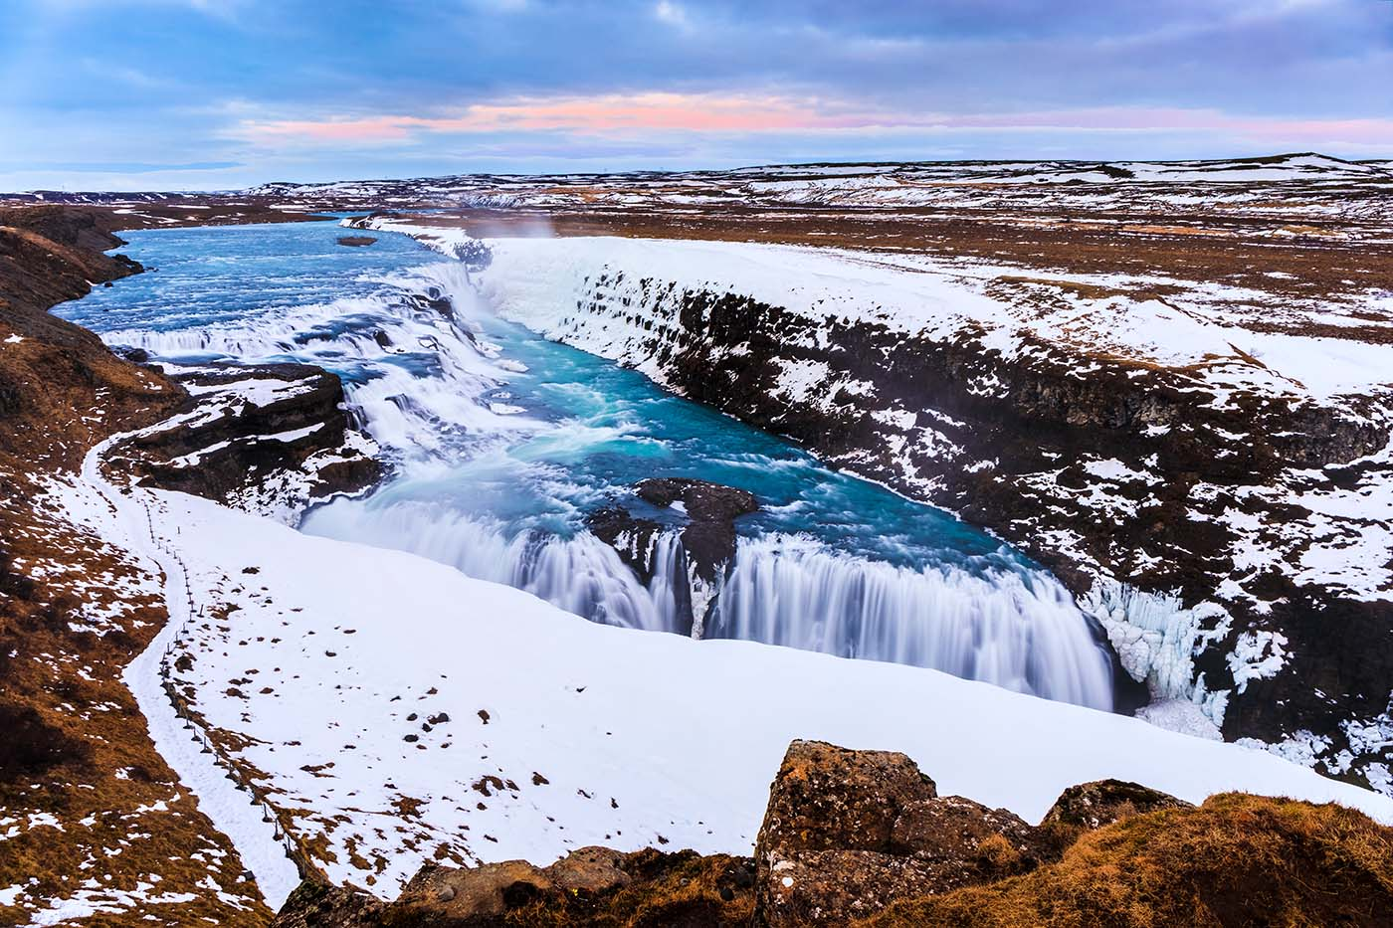
Where’s Wally?
4
Can you guess the country?
Notes:
Gullfoss Waterfall, Iceland

Slide 6
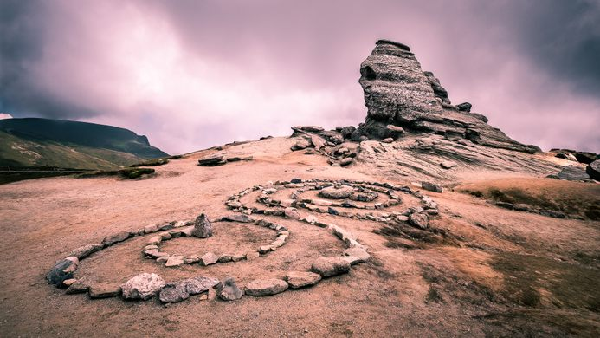
Where’s Wally?
5
Can you guess the country?
Notes:
The Sphinx, Romania

Slide 7
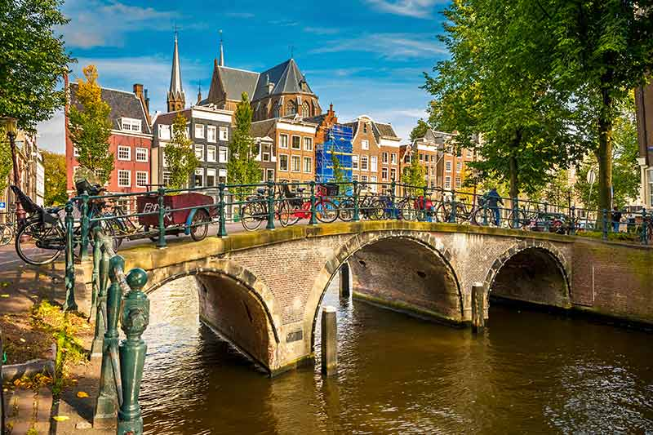
Where’s Wally?
6
Can you guess the country?
Notes:
Amsterdam, the Netherlands

Slide 8
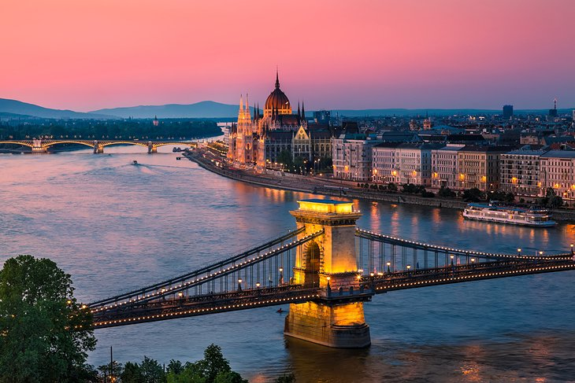
Where’s Wally?
7
Can you guess the country?
Notes:
Budapest, Hungary

Slide 9
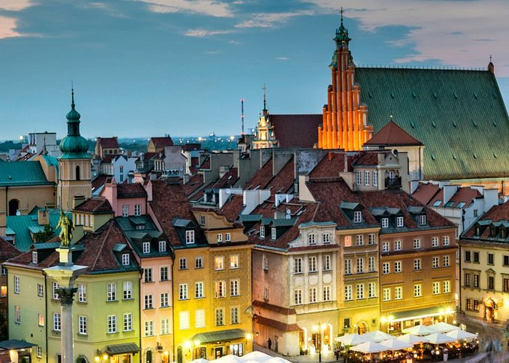
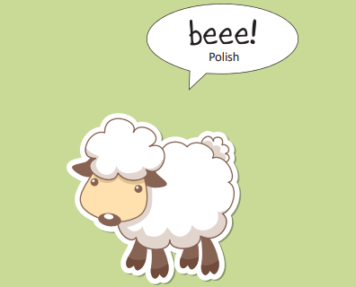
Where’s Wally?
8
Can you guess the country?
Notes:
Warsaw, Poland

Slide 10
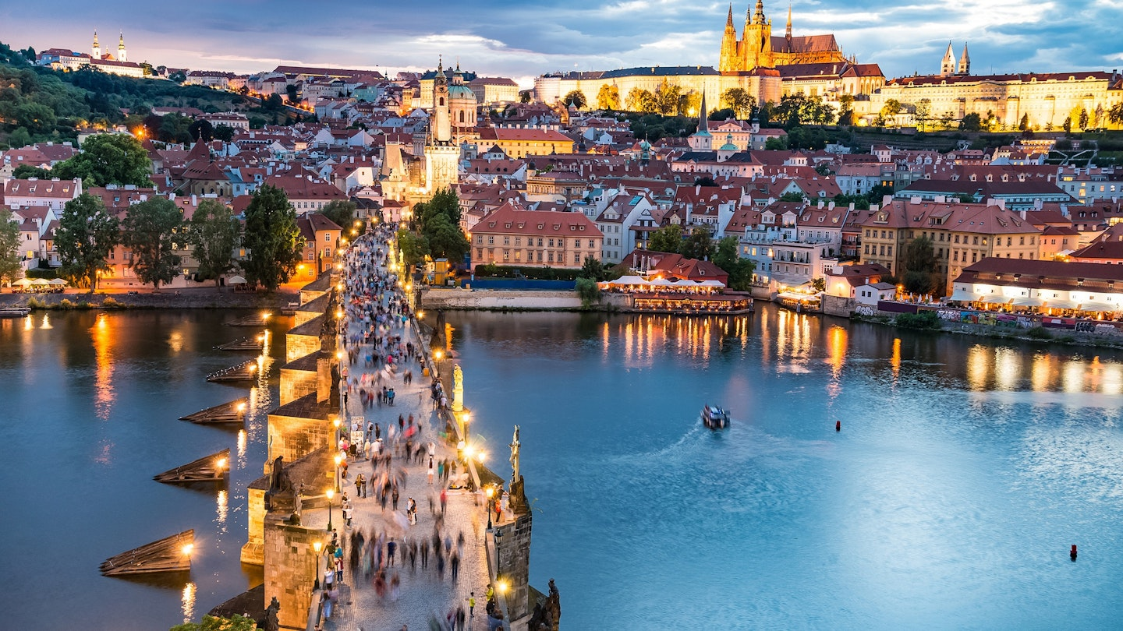
Where’s Wally?
9
Can you guess the country?
Notes:
Prague, Czech republic

Slide 11
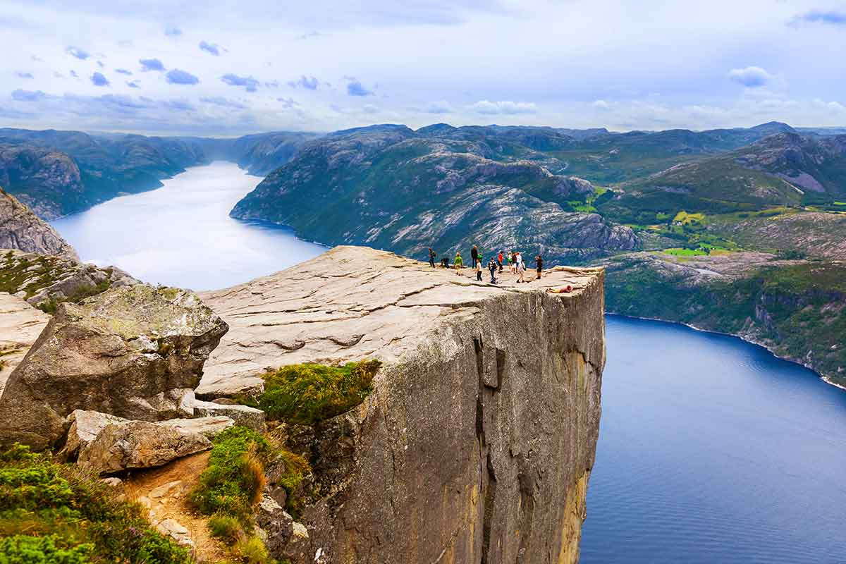
Where’s Wally?
10
Can you guess the country?
Notes:
Pulpit rock, Norway

Slide 12
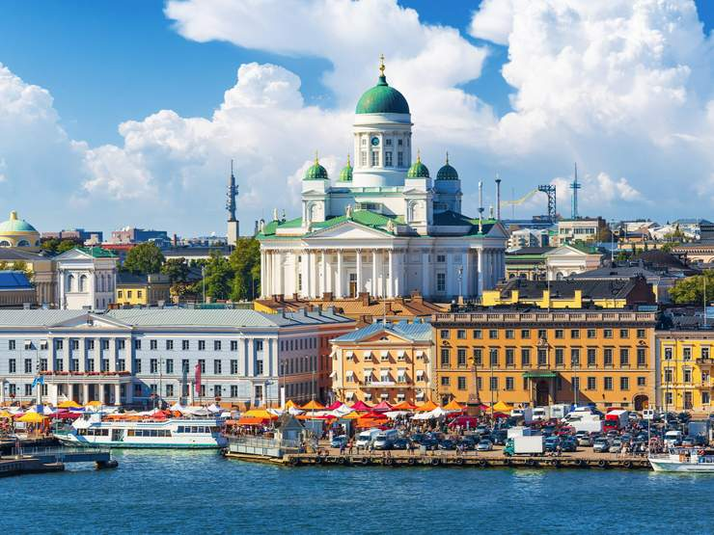
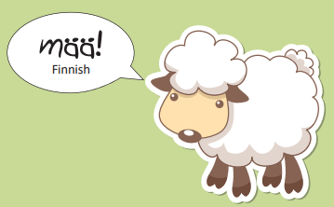
Where’s Wally?
11
Can you guess the country?
Notes:
Old town Helsinki, Finland

Slide 13
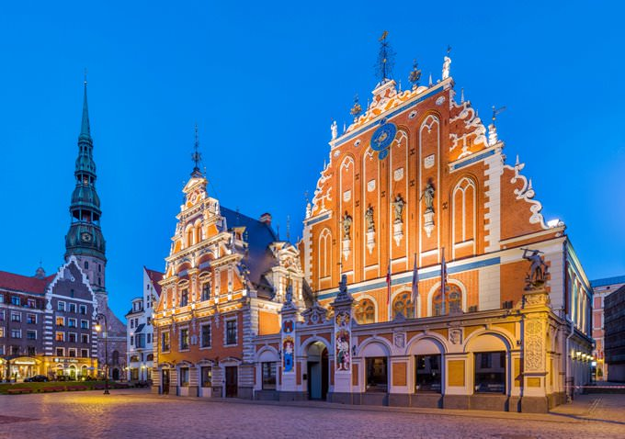
Where’s Wally?
12
Can you guess the country?
Notes:
Riga, Latvia

Slide 14
Answers
回答
Réponses
Slovenia
Greece
Spain
Iceland
Romania
Netherlands
Hungary
Poland
Czech republic
Norway
Finland
Latvia
respostas
risposte
Antworten
답변
答案
ответы
respuestas
Antwoorden

Slide 15
Tie breaker
回答
Réponses
respostas
risposte
Can you name the 10 languages on the board?
Antworten
답변
答案
ответы
respuestas
Antwoorden

Slide 16
Tie breaker
French: "réponses"
Spanish: "respuestas"
German: "Antworten"
Italian: "risposte"
Portuguese: "respostas"
Dutch: "antwoorden"
Russian: "ответы" (pronounced as "otvety")
Japanese: "回答" (pronounced as "kaitō")
Chinese (Simplified): "答案" (pronounced as "dá'àn")
Korean: "답변" (pronounced as "dapbyeon")

Slide 17
Let’s discuss
Have you visited any of these places?
Would you like to visit any of these places?
Have you ever been to a place where people spoke a different language? How did you communicate with them?
Notes:
Quick reflection/ discussion if there’s enough time

