Slide 1
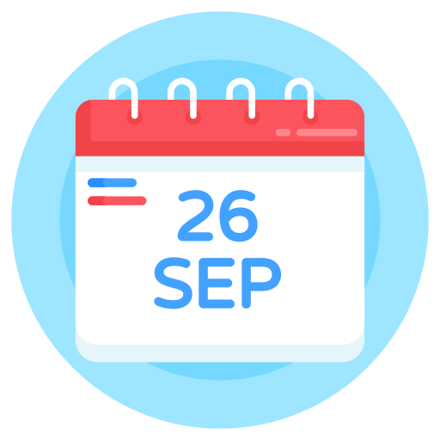
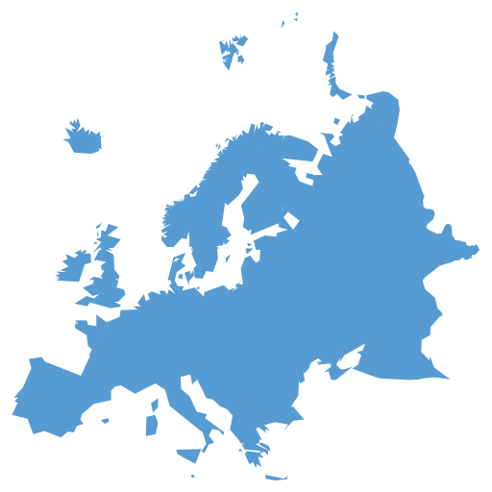
European day of languages
Do now: how many European languages can you name?
The European Day of Languages is an annual celebration held on September 26th to promote linguistic diversity and multilingualism in Europe.
It is an opportunity to celebrate the rich linguistic variety of Europe, which encompasses over 200 languages and dialects spoken across the continent.

Slide 2
European day of languages
Main languages in Europe
English
German
Dutch
Swedish
Danish
Norwegian
Spanish
French
Italian
Portuguese
Romanian
Russian
Polish
Ukrainian
Czech
Slovak
Bulgarian
Serbian
Croatian
Irish Gaelic
Scottish Gaelic
Welsh
Lithuanian
Latvian
Finnish
Hungarian
Estonian
Turkish
Greek
Maltese
Albanian
Basque
Georgian
Armenian
Icelandic
Faroese
Luxembourgish
Maltese
Manx Gaelic
Romani
Sámi languages (spoken by the indigenous Sámi people in northern Europe)
Notes:
Students may name some from this list

Slide 3
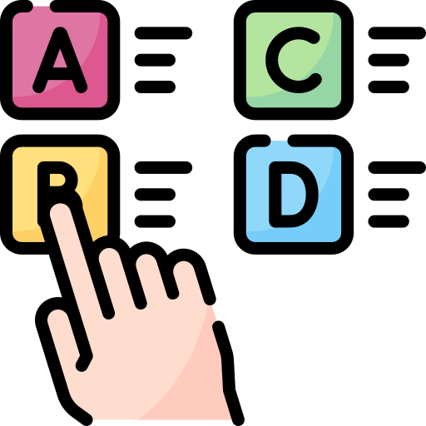
Which European language is it?
Read the statement and decide which European language matches the fact
Get into teams!
https://crowdcontrolgames.com/pages/crowd-buzzer
Notes:
Using crowd buzzer is optional but students love it. Can be done with mini whiteboards or using crowd buzzer (share code with students and they use their phones as buzzers. The software registers who was the first team to press the buzzer

Slide 4
How to use crowd buzzer
1. Click on this link. It will give you a code for the game and to share with students
https://crowdcontrolgames.com/pages/crowd-buzzer
2. Ask students to join the game (1 buzzer per team) They will need a team name
3. The teacher turns the buzzers ON and OFF. Students can’t press them until the teacher turns on the button (e.g. after asking a question)
4. The software shows the first team to press the buzzer so they can answer the question. If they answer incorrectly, you can choose the second fastest team as it gives you a list.

Slide 5
Which European language is it?
Read the statement and decide which European language matches the fact
1. ……….…..is the most widely spoken language in Europe. However, it does not have an official status in any European country.

Slide 6
Which European language is it?
Read the statement and decide which European language matches the fact
2. ………….. is the second most spoken language in the world, after Mandarin Chinese. It is also the official language in 21 countries.

Slide 7
Which European language is it?
Read the statement and decide which European language matches the fact
3. ………….. is known as the language of love. It is also an official language in 29 countries.

Slide 8
Which European language is it?
Read the statement and decide which European language matches the fact
4. ………….. is known for its long compound words that are created by combining multiple words together to form a new word with a specific meaning.

Slide 9
Which European language is it?
Read the statement and decide which European language matches the fact
5. ………….. is spoken by around 65 million people. It is known for its musicality and the use of hand gestures to communicate.

Slide 10
Which European language is it?
Read the statement and decide which European language matches the fact
6. ………….. is the largest native language in Europe, with over 150 million speakers. It uses the Cyrillic alphabet, which is different from the Latin alphabet used in many other European languages.

Slide 11
Which European language is it?
Read the statement and decide which European language matches the fact
7. ………….. is one of the oldest written languages in the world, with a history spanning over 3,000 years. It has had a significant influence on the development of Western literature and philosophy.

Slide 12
Which European language is it?
Read the statement and decide which European language matches the fact
8. ………….. has an interesting feature called "en-dash words." These are compound words created by combining two words with an en-dash, such as "fika-kaffe" (coffee for a social break) or "skrivbord-lampa" (desk lamp).

Slide 13
Which European language is it?
Read the statement and decide which European language matches the fact
9. ………….. is the official language of several countries, including East Timor, in Southeast Asia.

Slide 14
Which European language is it?
Read the statement and decide which European language matches the fact
10. ………….. is closely related to German and English, with similar vocabulary and sentence structure. It is the official language of the Netherlands, Belgium, and Suriname.

Slide 15
Which European language is it?
Answers
English
Spanish
French
German
Italian
Russian
Greek
Swedish
Portuguese
Dutch

Slide 16
Let’s discuss
Why is it important to celebrate the European Day of Languages?
How can learning different languages help us understand and respect other cultures?
What exciting things can happen when we know more than one language?
Can you think of a time when you heard someone speaking a language you didn't understand? How did that make you feel?
Have you ever been in a situation where knowing another language would have been helpful? How?
Notes:
Quick reflection/ discussion if there’s enough time

